Slide 1

ECE 281 Lesson 30
1

Slide 2
Lesson 30 Outline
Do Time Logs!
OBJECTIVES
Understand the 3 instruction types
Convert assembly to machine code for all instruction types
Machine code to assembly for all instruction types
Addressing Modes
Practice using your reference sheets!
Verify results and practice assembly in MIPS simulator
K:\DF\DFEC\ECE281\Handouts and Resources\Past GRs

Slide 3
MIPS Architecture
The MIPS Architecture consists of:
A set of operations (instructions)
I-Type, R-Type, J-Type
Data units (sizes, addressing modes, etc.)
32-Bit Data Word
Registers
32, 32-bit registers
Interaction with memory
Harvard Architecture
Load and Store
Program counter
32-bit PC

Slide 4
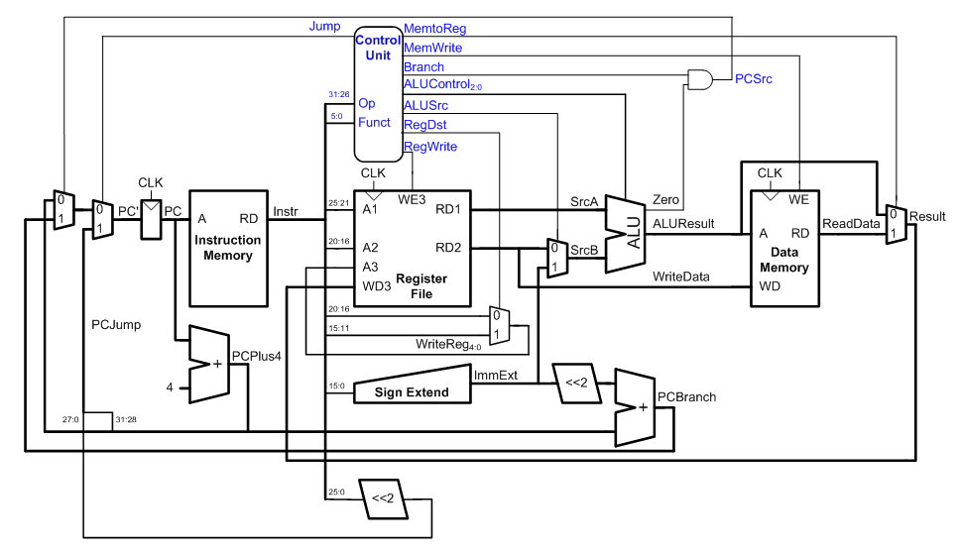
Single Cycle MIPS microArch

Slide 5
MIPS Instruction Types
R-Type Instructions – Register Type
I-Type Instructions – Immediate Type
J-Type Instructions – Jump Type
R-Type
op | rs | rt | rd | shamt | funct
6 bits | 5 bits | 5 bits | 5 bits | 5 bits | 6 bits
I-Type
op | rs | rt | imm
6 bits | 5 bits | 5 bits | 16 bits
J-Type
op | addr
6 bits | 26 bits

Slide 6
I-Type Instructions
I-Type Instructions – Immediate Type
Uses 2 registers operands and 1 immediate operand
Example Assembly Instruction:
instr rt, rs, imm
instr rt, imm (rs)
Boardwork: addi $s0, $0, 4
I-Type
op | rs | rt | imm
6 bits | 5 bits | 5 bits | 16 bits
(e.g. addi & andi)
(e.g. lw & sw)
What is the Difference between SignImm and ZeroImm?

Slide 7
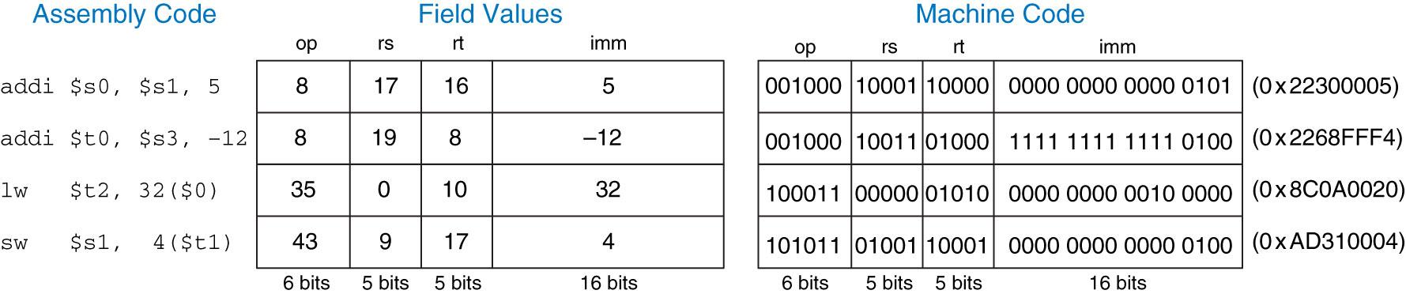
I-Type Instructions
addi is SignImm (sign extended) because the value could be negative
Figure 6.9 Machine code for I-type instructions
Copyright © 2013 Elsevier Inc. All rights reserved.

Slide 8
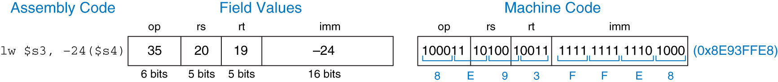
I-Type Instructions
Figure 6.10 Machine code for an l-type instruction
Copyright © 2013 Elsevier Inc. All rights reserved.

Slide 9
J-Type Instructions
J-Type Instructions – Jump Type
j or jal (jr is an R-Type Instruction that uses only the rs operand)
J-Type
op | addr
6 bits | 26 bits
Copyright © 2013 Elsevier Inc. All rights reserved.

Slide 10
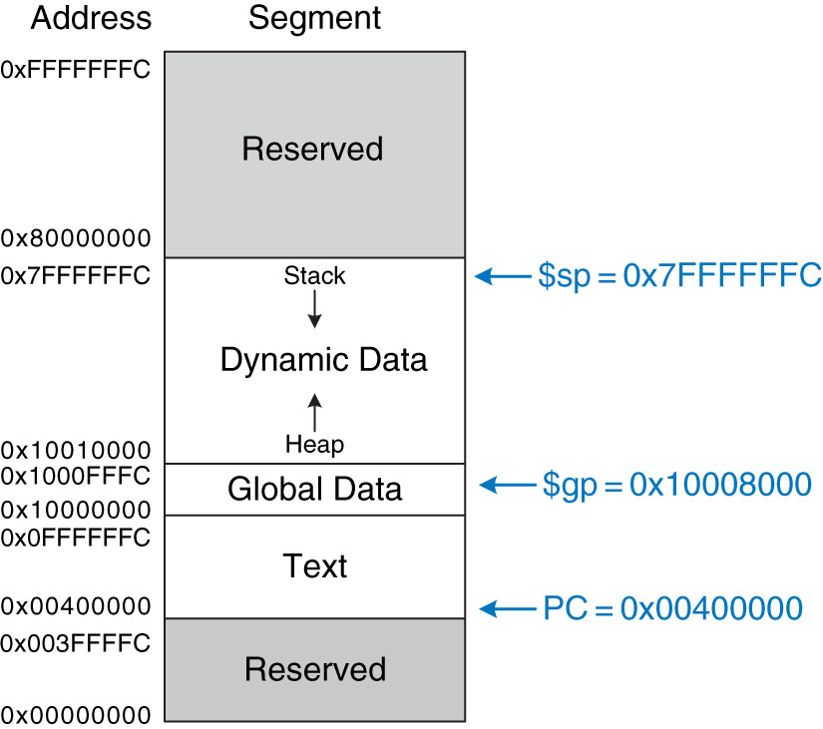
MIPS Memory Map
Figure 6.31 MIPS memory map
Copyright © 2013 Elsevier Inc. All rights reserved.

Slide 11
J-Type Instructions
Given this code convert Jump:
0x00400000 addi $s0, $0, 4 # $s0 = 4
0x00400004 addi $s1, $0, 1 # $s1 = 1
0x00400008 j target # jump to target
0x0040000c addi $s1, $s1, 1 # not executed
0x00400010 sub $s1, $s1, $s0 # not executed
target:
0x00400014 add $s1, $s1, $s0 # $s1 = 1 + 4 = 5
J-Type
op | addr
6 bits | 26 bits
Copyright © 2013 Elsevier Inc. All rights reserved.

Slide 12
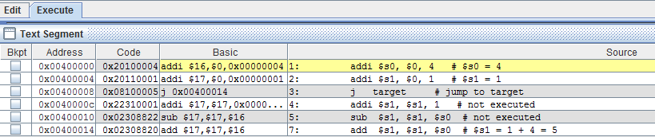
Verify in MIPS MARS Simulator
Copyright © 2013 Elsevier Inc. All rights reserved.

Slide 13
J-Type Instructions
# This is not a good program. It is just for practice for verifying j instruction machine code
main: addi $sp, $sp, -4
sw $ra, 0($sp)
addi $a0, $0, 2
sw $a0, 0($0) # dummy statement
addi $a1, $0, 3
sw $a1, 0($0) # dummy statement
jal sum # FIND MACHINE CODE (sum is at 0x0040002C)
sw $v0, 0($0) # dummy statement
lw $ra, 0($sp)
addi $sp, $sp, 4
jr $ra
sum: add $v0, $a0, $a1
jr $ra

Slide 14
MIPS Instruction Types
R-Type Instructions – Register Type
I-Type Instructions – Immediate Type
J-Type Instructions – Jump Type
R-Type
op | rs | rt | rd | shamt | funct
6 bits | 5 bits | 5 bits | 5 bits | 5 bits | 6 bits
I-Type
op | rs | rt | imm
6 bits | 5 bits | 5 bits | 16 bits
J-Type
op | addr
6 bits | 26 bits

Slide 15
Addressing Modes
5 Addressing Modes (MIPS only)
Register-Only
Uses registers for all source & destination operands
All R-Type Instructions use this mode.
Immediate
Use 16-bit immediate & registers as operands
Used by some I-type instructions (eg addi, lui)
Base
Effective address of memory operand found by adding base address in rs to sign extended immediate (offset)
Used by lw, sw, etc
Sign vs zero extended 16-bit immediate
6
-6

Slide 16
Addressing Modes Cont.
PC Relative
What is PC? – Program counter
Used by conditional branch instructions
16-bit immediate is added to PC to give new PC; address is relative to current PC
branch target address is where you branch to
16-bits gives # instructions after next instructions (eg PC+4+imm)
imm is calculated by processor
Pseudo-direct
Address specified in j instruction
4 MSBs come from PC+4
2 LSBs are 0 because addresses are word aligned
Jump target address calculated by PC

Slide 17
Saving Registers on the Stack
Since MIPS doesn’t have Push, Pop, and Peek instructions:
Code Example 6.25 Function Saving Registers on the Stack
MIPS Assembly Code
# $s0 = result
diffofsums:
addi $sp, $sp, -12 # make space on stack to store three registers
sw $s0, 8($sp) # save $s0 on stack
sw $t0, 4($sp) # save $t0 on stack
sw $t1, 0($sp) # save $t1 on stack
add $t0, $a0, $a1 # $t0 = f + g
add $t1, $a2, $a3 # $t1 = h + i
sub $s0, $t0, $t1 # result = (f + g) - (h + i)
add $v0, $s0, $0 # put return value in $v0
lw $t1, 0($sp) # restore $t1 from stack
lw $t0, 4($sp) # restore $t0 from stack
lw $s0, 8($sp) # restore $s0 from stack
addi $sp, $sp, 12 # deallocate stack space
jr $ra # return to caller

Slide 18
Practice 1
Convert the following to assembly
if (g > h)
g = g + h;
else
g = g - h;
Reference Code Example 6.10 and 6.11 for 16-bit and 32-bit constant initialization
Let $s0 = g and $s1 = h
Let’s use these instructions:
slt rd, rs, rt if rs < rt, then rd = 1, else rd = 0
beq rs, rt, label if rs = rt, then branch to label

Slide 19
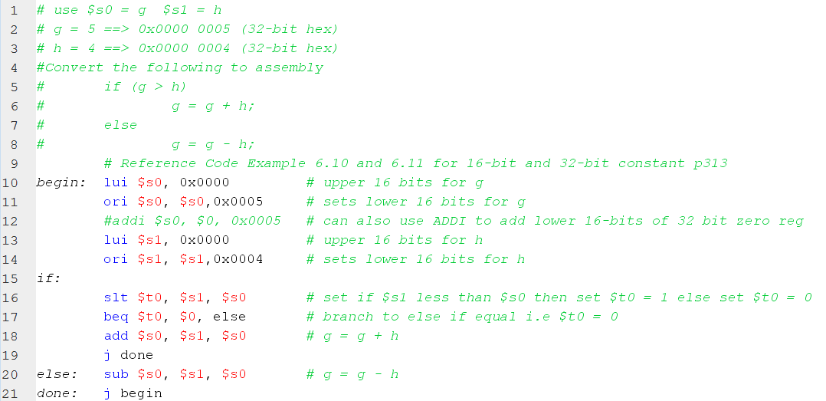
Practice 1 solution

Slide 20
Practice 2
Convert the following to assembly
for (i = 0; i < 20; i++)
{
a = a + 2*i;
}
Let $s0 = i $s1 = a $t0 = 20

Slide 21

21

Slide 22
MIPS Instruction Types
R-Type Instructions – Register Type
I-Type Instructions – Immediate Type
J-Type Instructions – Jump Type
R-Type
op | rs | rt | rd | shamt | funct
6 bits | 5 bits | 5 bits | 5 bits | 5 bits | 6 bits
I-Type
op | rs | rt | imm
6 bits | 5 bits | 5 bits | 16 bits
J-Type
op | addr
6 bits | 26 bits

Slide 23
Machine Code to Assembly
Find the Assembly Function:
Given Machine Code: 0xAD310004

Slide 24
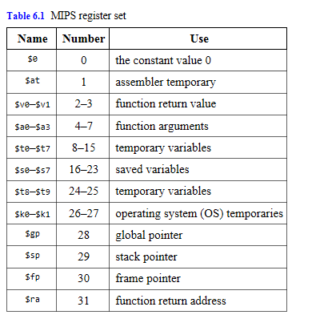
MIPS Register Set
Copyright © 2013 Elsevier Inc. All rights reserved.

Slide 25
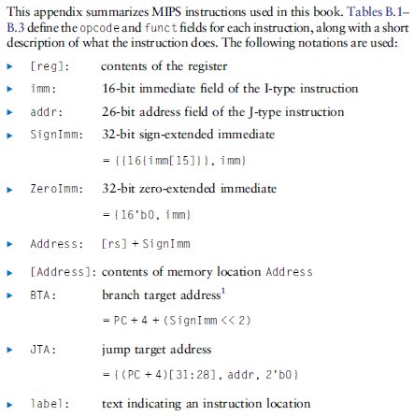
MIPS Instruction Set
Copyright © 2013 Elsevier Inc. All rights reserved.

Slide 26
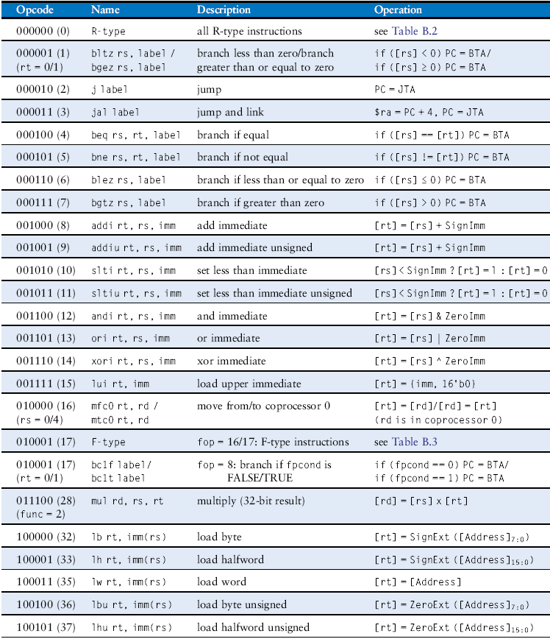
MIPS Instruction Set
Table B.1 Instructions, sorted by opcode
Copyright © 2013 Elsevier Inc. All rights reserved.

Slide 27
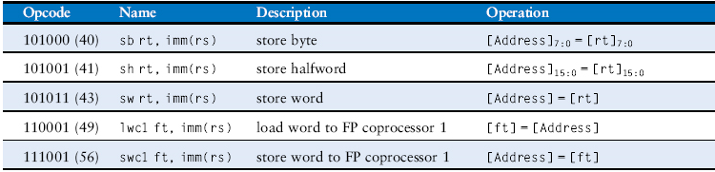
MIPS Instruction Set
Table B.1 Instructions, sorted by opcode
Copyright © 2013 Elsevier Inc. All rights reserved.

Slide 28
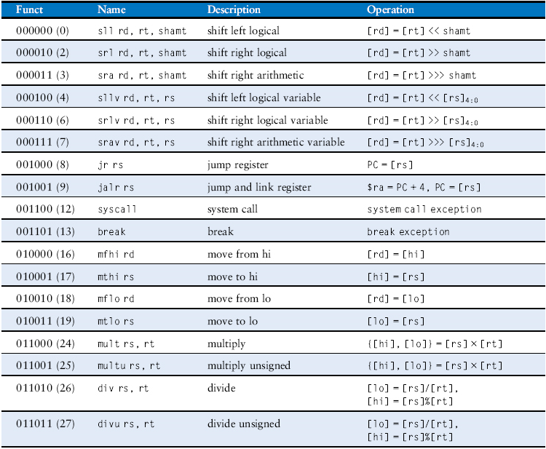
MIPS Instruction Set
Table B.2 R-type instructions, sorted by funct field
Copyright © 2013 Elsevier Inc. All rights reserved.

Slide 29
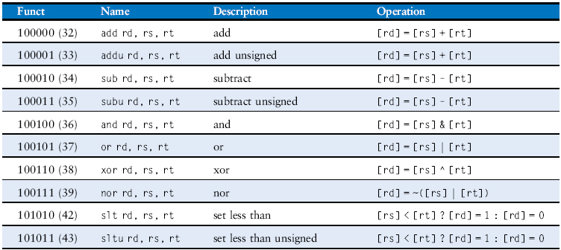
MIPS Instruction Set
Table B.2 R-type instructions, sorted by funct field
Copyright © 2013 Elsevier Inc. All rights reserved.

Slide 30
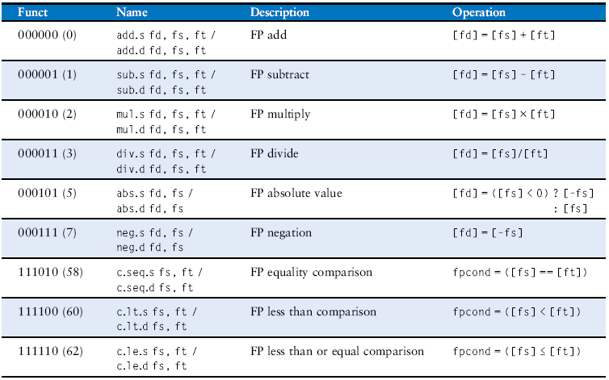
MIPS Instruction Set
Table B.3 F-type instructions (fop = 16/17)
Copyright © 2013 Elsevier Inc. All rights reserved.

